Slide 1

Identifying transport profiles of England and Wales
Philip Wilkinson
Cheyne Campbell
Alicja Kotarba
Nathanael Sheehan
Hussein Mahfouz
Notes:
Good evening, we are the Spider Cartographers, and we’re going to explain how we chose to analyse and visualize transportation in the UK….so buckle up!
We will first begin with a presentation of the data side, which will be followed up by an exploration of the website.

Slide 2
Purpose & AIMS
Purpose
Inform policy and the general public of the differences in transport usage to travel to work across England and Wales
Aims
Identify different transport profiles
Map the transport profiles and flows
Look at how demographic factors are related to these transport profiles
Notes:
Ok what was our purpose? We want to gain a better understanding of how transport is experienced throughout the UK. Such an understanding can be used to inform both policy and the general public.
As the UK shifts towards more sustainable modes of transport, our work aims to improve understanding of the current transportation ecosystem so as to better inform such a shift.
Therefore, the aims of our analysis and website was to be able to identify and group different transport profiles across England and Wales at the MSOA level. These groups could then be mapped, along with transport flows, to see the geographic distribution of transport usage.
We also demonstrate how we can use the identified profiles to see what demographic factors relate to the way in which we may use transport

Slide 3
Pre-processing
Collection: gather data to be used for analysis
Transformation: reduce skewness of the data
Standardisation: put variables in the same units and scale
Cleaning: get data in the correct format and units
Notes:
Before identifying these transport profiles, there were a few steps we had to go through: gathering the data, cleaning it, transforming it and standardizing it

Slide 4
Data
Public transport stops – Department of Transport (2014)
Car ownership – 2011 census
Commuter Flow Data – 2011 census
Travel Time Data – Quant Project CASA
Notes:
For this to work we required data on transportation usage across England and Wales. This was gathered at the MSOA level given that this was the lowest geographical scale for which all data was available. The datasets covered transport access nodes, car ownership, commuter flow data between MSOAs and travel time, the latter being a proxy for accessibility.

Slide 5
Cleaning
Group flows by origin MSOA and turn into percentages
Perform a point in polygon analysis for transportation access nodes
Turn commuting flows into average travel time data and accessibility measures
Notes:
The data that was received was in different formats and not all fit for our purpose. Some of the cleaning process we did included
Grouping the flows by origin MSOA and turning them into percentages so that they could be readily compared.
Conducting a point in polygon analysis was for transport access nodes to see how many transport access nodes were in each MSOA.
Weighing travel times between MSOAs by the flows that occur between them. This allowed us to get an average of actual commuting times by mode for each MSOA, which was used as an accessibility metric

Slide 6
Transformation and standardisation
Transformation
Log transformation
Standardisation
Z-score
Yeo-Johnson transformation
Range
Inter-Decile Range
Notes:
Once the data was cleaned, we had to transform and standardise it. Firstly transformation was used because extremes and outliers are likely influence cluster formation, especially for algorithms using distance-based metrics. Our variables were not skewed in the same degree or necessarily in the same direction, so we used two different transformation techniques
Clustering results will also be affected by differences in units, ranges and variations. Therefore the data was standardised after transformation. Again due to the different variable distributions, no single standardization technique fit our data best, so we used three in order to compare the result.
The resulting outputs were all pushed to a single csv.

Slide 7
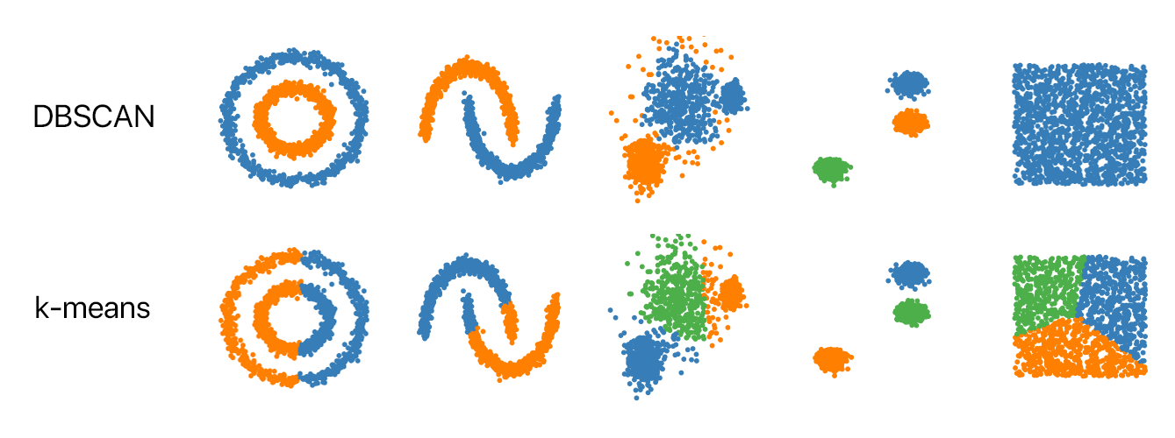
Clustering
Kmeans
Hierarchical (Agglomerative)
DBScan
Picture taken from: https://github.com/NSHipster/DBSCAN
Notes:
Once the data had been cleaned, transformed and standardised we could then perform the clustering process. To this end we could not explore the data before hand due to the high dimensionality of using many different factors. Therefore we performed three different clustering methodologies to be able to compare the results given the different underlying assumptions and the way the analysis is performed. This included Kmeans, hierarchical and DBScan clustering algorithms from the SKLearn package in Python.

Slide 8
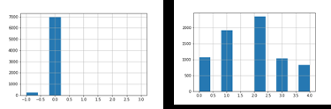
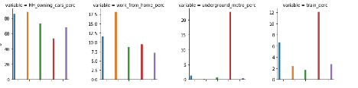
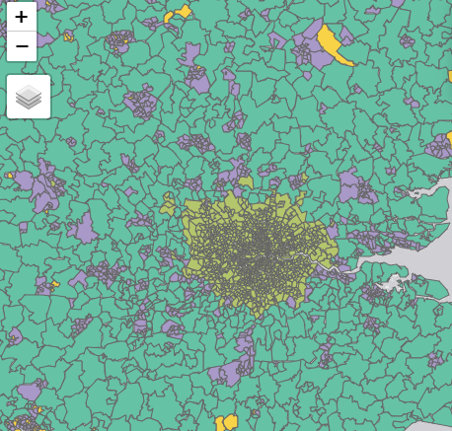
Clustering: Evaluating outputs
Notes:
In order to determine the correct number of clusters for both kmeans and hierachial we used silhouette plots and elbow plots.
From this we could then evaluate the outputs.
In order to evaluate the clustering outputs and choose the one that best represented reality we first plotted the distribution of MSOAs assigned to each cluster. This was because a clustering output that assigned MSOAs to a single cluster could not be said to be representative and therefore potentially biased. The second step to interpret these was to explore the distribution of variables within each cluster to see whether there was meaningful differentiation and there was interpretability. Finally, we plotted the results to see whether the different cluster profiles matched with geographic reality.

Slide 9
clustering: Chosen workflowCLUSTERING: CHOSEN WORKFLOW
log transformation
z-score standardization
k-means clustering
Notes:
The final workflow chosen was that following log transformation, z-score standardisation and then k-means clustering.

Slide 10
Clustering: resultsCLUSTERING: RESULTS
Profile 1: Good train accessibility but car dependant
Profile 2: Solely car dependant
Profile 3: Lack of accessibility across all Transport mode
Profile 4: High public transport and good accessibility
Profile 5: Car reliant but high public transport
Notes:
The result of this were five different transport profiles across England and Wales that made intuitive sense. This included which can be seen on the interactive map and are explained on the website.

Slide 11
Classification
Data Used
Net annual income (£)
Population Density
Unemployment Rate
Education Level
Household Ownership
Household Size
Health
Age
Religion
Employment
Female Employment
Full-time Employment
Notes:
To explore our final aim we ran a classification algorithm to see which demographic factors were related to each of the transport profiles. The data for this included income, population density, employment etc which previous literature had suggested was related to transport usage.

Slide 12

Classification
Random forest
100 trees with a max depth of 3 to aid interpretability
Accuracy shows that 65% of MSOAs are correctly classified by the model
Most important features: population per hectare and net annual income (£)
Interpretability could come from exploring the individual trees
Notes:
The algorithm used for this was random forest with 100 trees and a max depth of 3. This latter condition was to help aid interpretability when examining individual trees. The accuracy of this shows that given the training data, the algorithm was able to correctly predict 65% of the test MSOAs. The most important features for this were population per hectare and net annual income. We can begin to understand how the algorithm worked and performed by exploring individual decision trees.

Slide 13
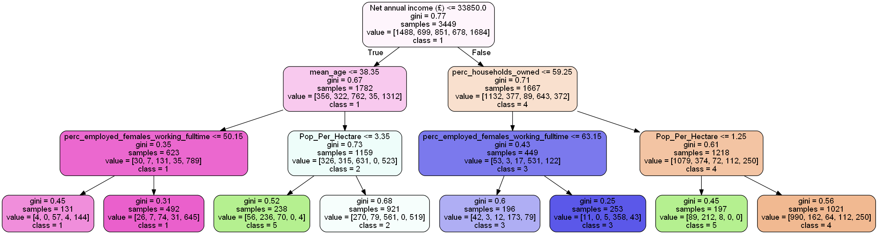
Classification RESULTS
Notes:
An example of one of the decision trees is provided here. As can be seen, cluster 4 with ‘high public transport and good accessibility ’ is suggested to have an income above £33,850 and the percentage of households owned is greater than 59.25%. While in contrast, cluster 1 ‘good train accessibility but still car dependent’ is associated with an income below £33,850 and a mean age less than 38.25.
If given more time and resources these trees would be explored more in depth to get a better understanding of the factors that are related to transport behaviour in the UK.
We will now hand over to the web team to explore the website.

Slide 14
WEB VISUALIZATION
Notes:
Okay, now we will discuss how the previously described data analysis was translated into a website, in order to make the findings and the analysis process accessible to a general audience.
As we will see, this objective informed our choices for the content and the design of the site.

Slide 15
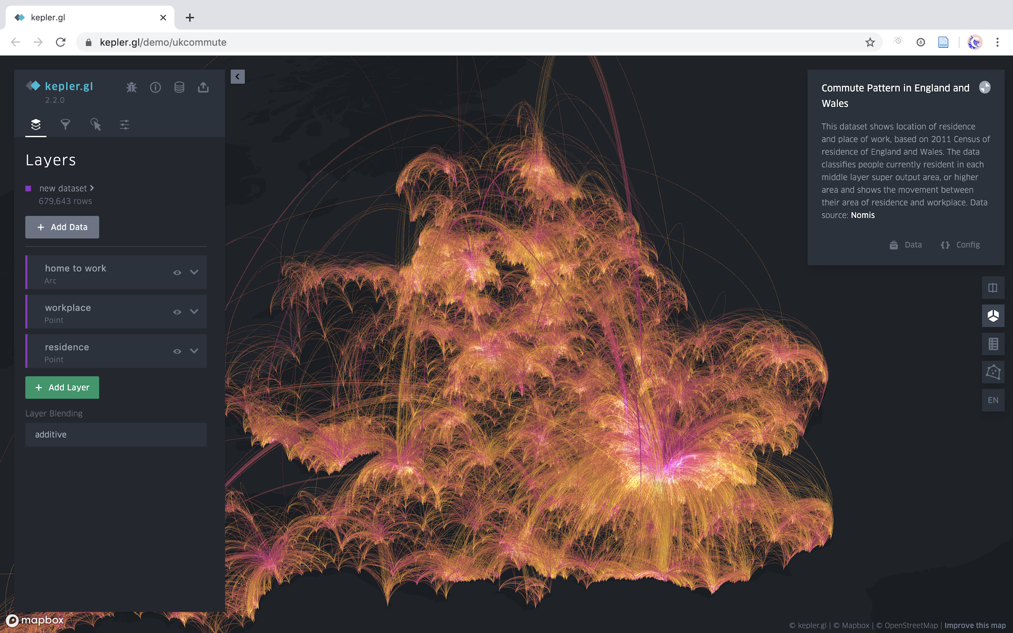
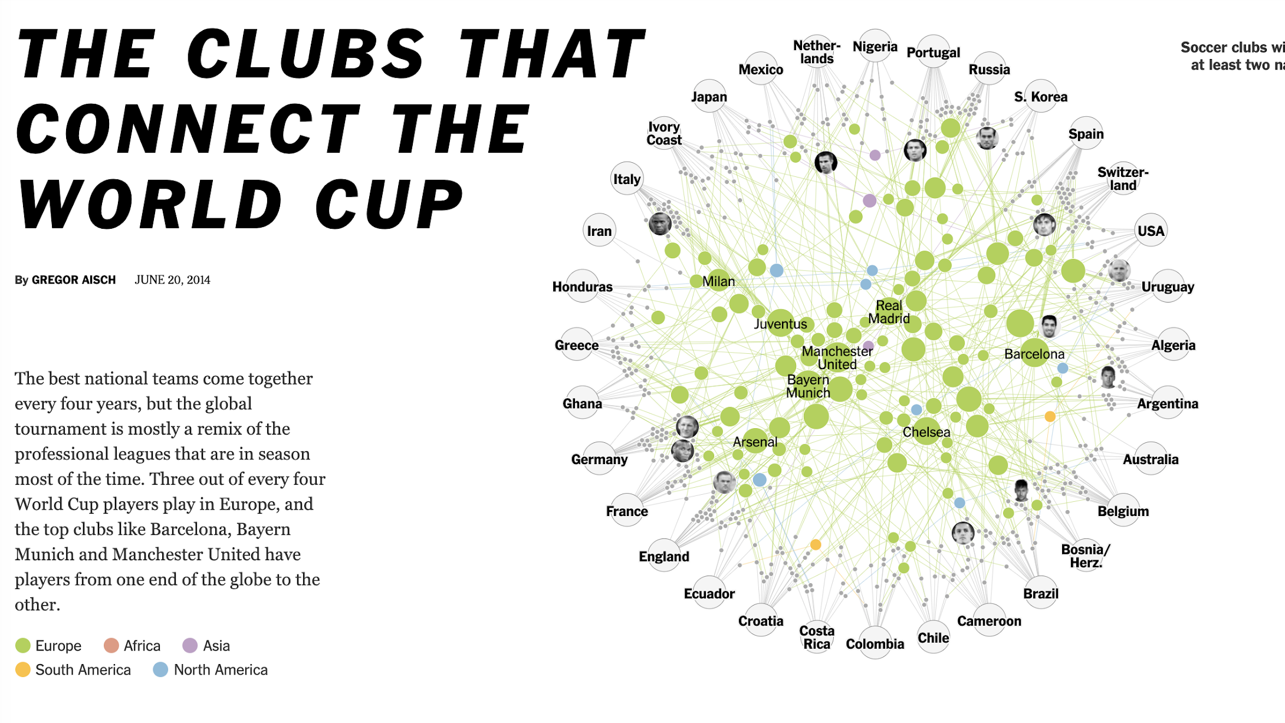
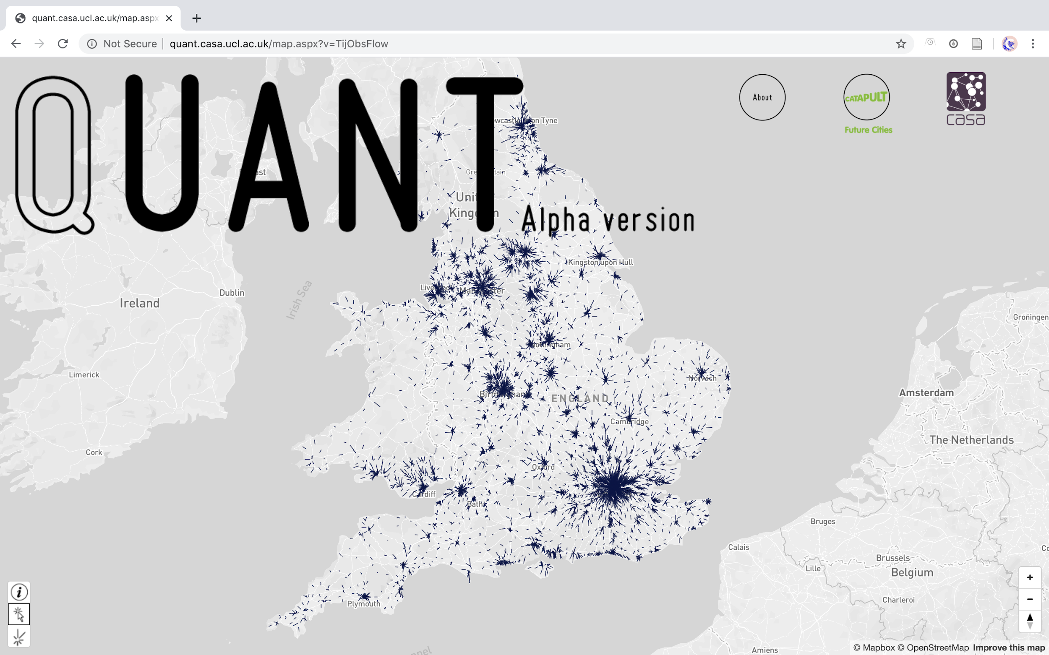
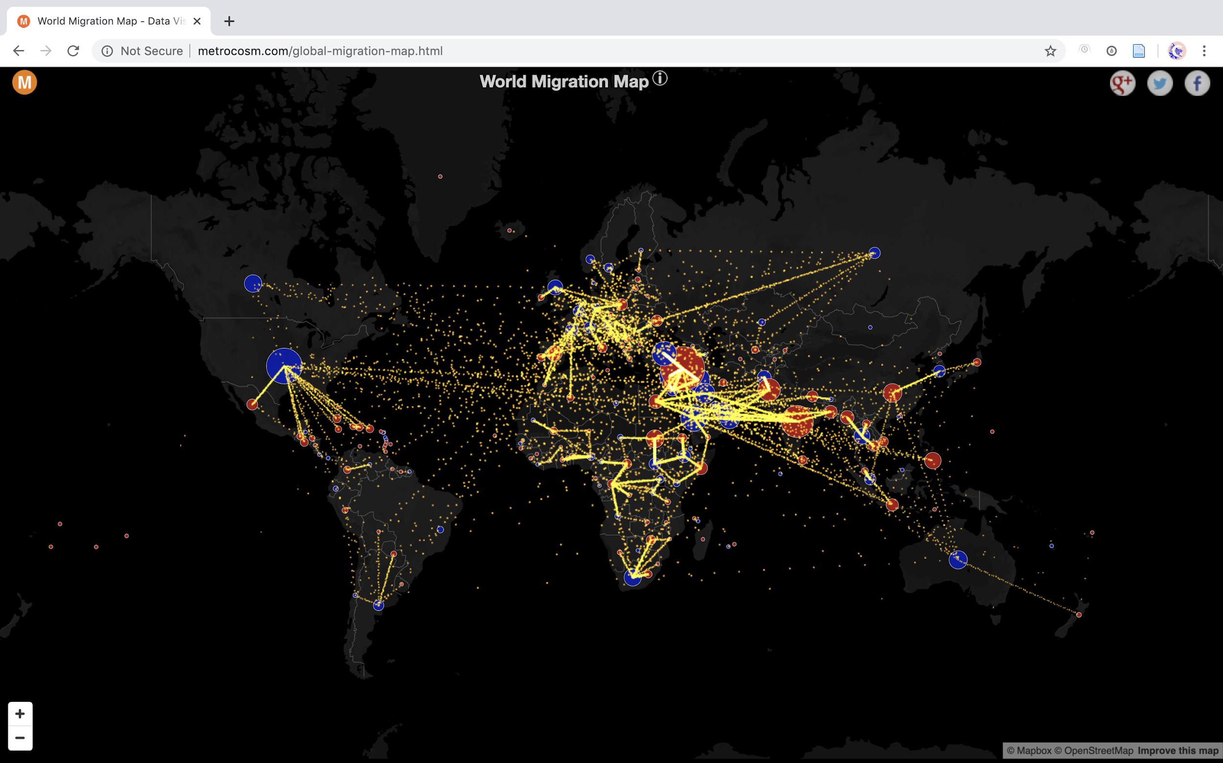
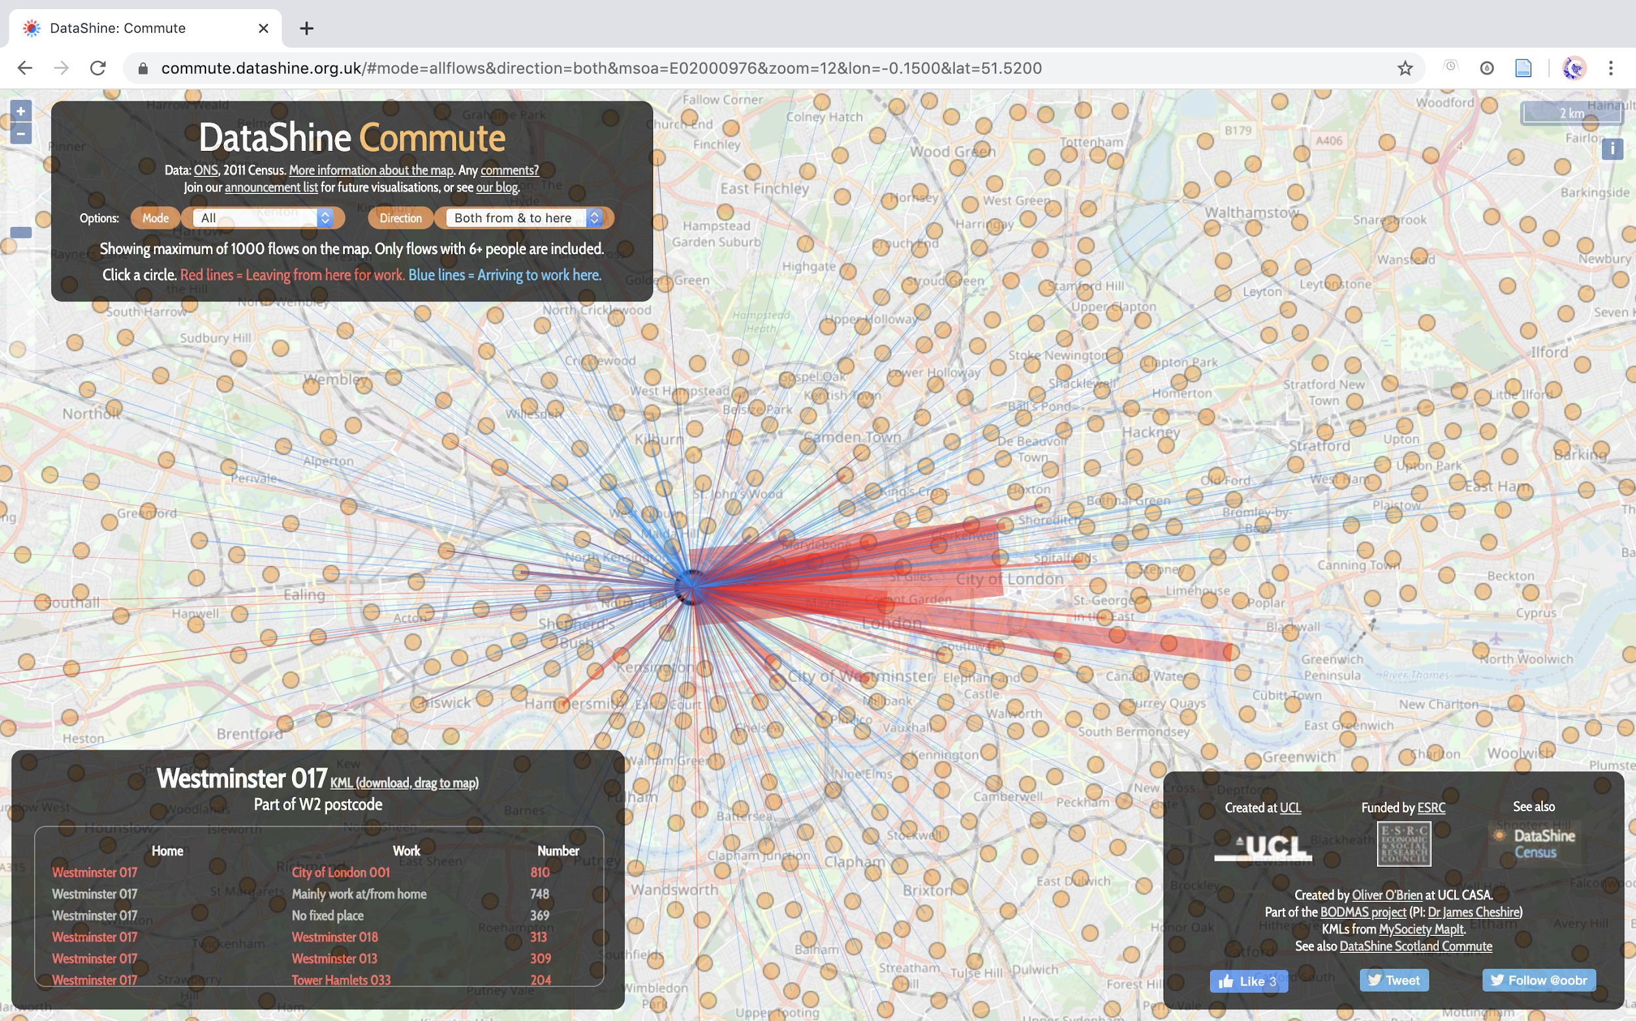
Notes:
To get ideas for our website, we looked at some examples of existing websites that had story telling elements or that pertained to the topics of migration or commuting.
This included a kepler.gl site, the QUANT website from CASA, the World Migration Map by Galka on Metrocosm, the DataShine Commute website from O’Brien at CASA, and The Clubs that Connect the World Cup from the New York Times.
From each of these websites, we were able to gain an understanding about what is conventional when it comes to visualizing this kind of data, as well as get ideas for the general arrangement and storytelling techniques used in our site.

Slide 16
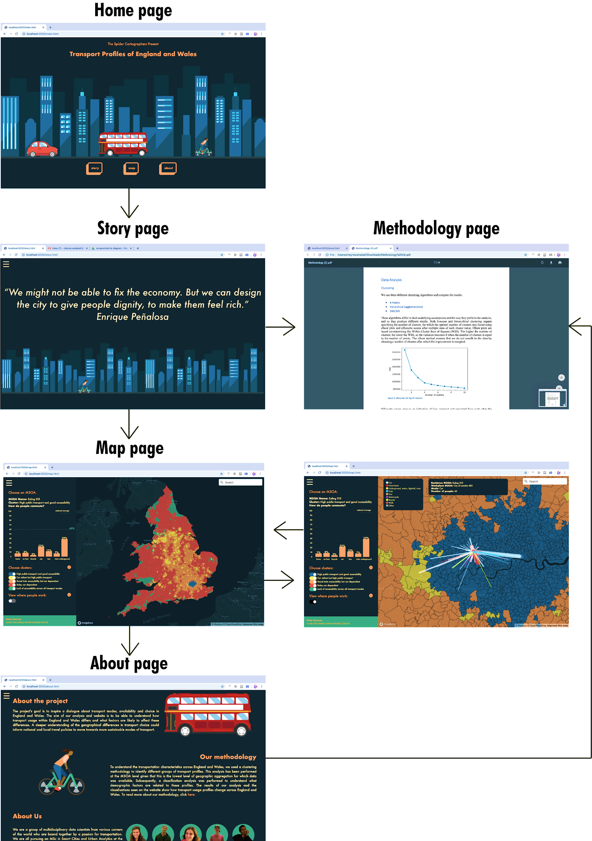
Site structure
RECOMMENDED USER’S JOURNEY
Notes:
Essentially, our site is divided into a homepage, story page, interactive map page, and about page, and the user is advised to peruse these pages in a certain order to best enhance their experience.
While our site offers the user freedom of exploration, we will demonstrate the recommended user journey in a few minutes, which is also shown in this diagram.

Slide 17

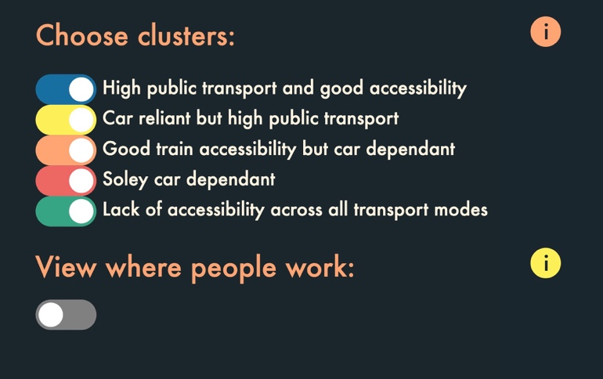
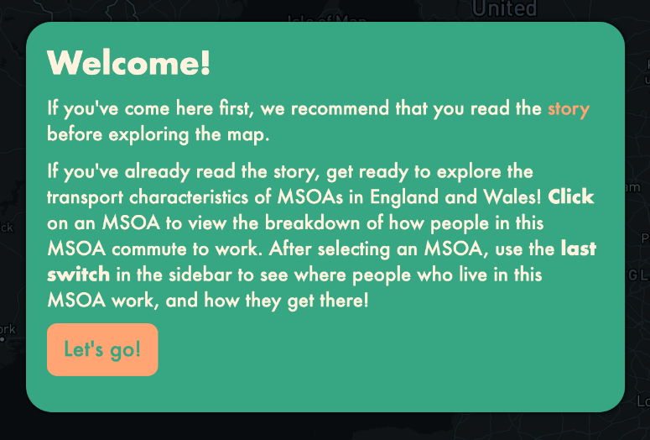
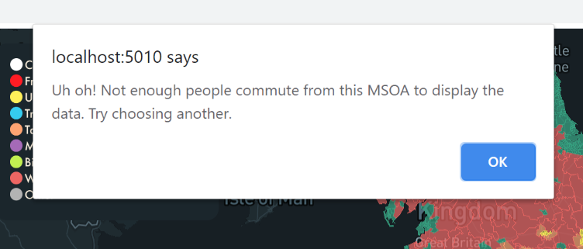
Nielsen’s 10 Usability heuristics for user interface design
Notes:
We built our site on the best UX (user experience) and UI (user interface) practices, mainly based around Nielsen’s 10 Usability Heuristics.
The images on the screen represent a few examples from our website:
The first picture shows clickable icons on the map page dashboard, which provide an additional information the user might need while exploring the map page. This goes in line with Nielsen’s 10th heuristic, “help and documentation”.
We tried to make the website intuitive and coherent. We used a single colour palette, a consistent placement of our burger menu, the same hover styling for links, as well as transport icons that can be seen on every page. These choices correspond with Nielsen’s fourth heuristic, “consistency and standards” as well as the eight heuristic, “aesthetic and minimalist design”.
Since we’re aiming at general audience, the language we used across all pages is understandable and not overly technical for anyone, which is an example of Nielsen’s second heuristic, “matching between the system and the real world”.
Finally, we’ve ensured the user is informed if anything goes wrong. An example on the screen shows a pop up box indicating that there is a problem.
My colleague Nathanael will now speak about the system architecture of our site.

Slide 18
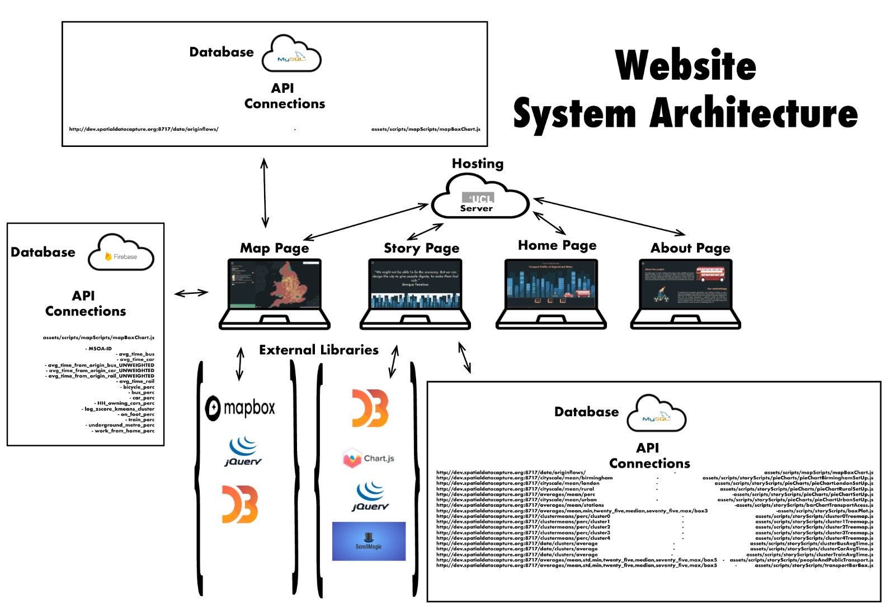
SYSTEM ARCHITECTURE
Notes:
NATHANAEL
The diagram on this screen outlines how our website takes form, displaying the interwoven relationship between external libraries, hosting and databases . Our website is hosted on the UCL server. This wasn’t originally the plan, for the majority of development, the website was hosted on a firebase server. However due to time and HTTP & HTTPS conflicts we agreed to host on UCL, where post submission we plan to migrate back to Firebase. Both the Map and Story page required external libraries and API connection. The Map page connected to two databases, firstly it connects to the Firebase DB, where JSON data is fetched from a REST API to display cluster information on a MSOA level. Additionally, it connects to the UCL API where it retrieves flow data. The map page used several Mapbox API’s and services, these included the vector tiles API, the gecoder API and Mapbox studio. The dynamic graph in the map page dashboard is generated using D3. Jquery is used to handle ajax. The story page is only connected to the UCL API, where a range of API calls are made for data visulsation using D3 and ChartJS. Jquery is used in conjunction with ScrollMagic to create a blur transition between sections of the story. NEXT SLIDE

Slide 19
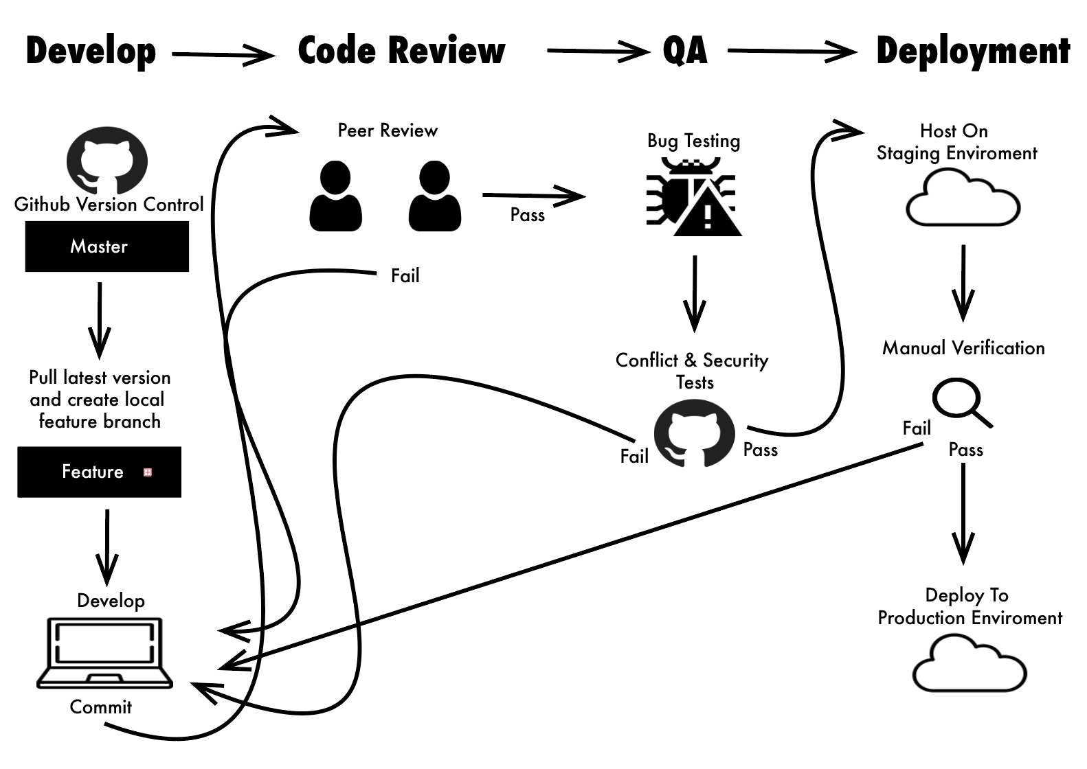
CONTINUOUS INTEGRATION AND CONTINUOUS DEVELOPMENT
Notes:
nathanael
In order to adhere to agile software development methodologies a CICD process was developed. With 5 developers working in five locations, this was an important feature to mitigate merge conflicts, bugs and errors. Whats more, this allowed for everyone to know the progress each person had made with a task. This featured some comical commit messages such as: “Big chunky code”, “IDK what this means but it wont let me commit to another branch” and “My bad”.. NEXT SLIDE.

Slide 20
Ideas for future improvements
mobile responsiveness
expand interactivity to allow direct engagement with algorithms
further exploration of deck.gl for flows visualisation
improved security
usability assessment followed by various UX and accessibility improvements
Notes:
nathanael
While we aimed to be as thorough as possible in our web development process, there were inevitably a few areas for improvement in the future. These include incorporating mobile responsiveness, expanding interactivity to include direct engagements with algorithms, exploring other ways to display the flows, improving security by hosting with HTTPS, and conducting a useability assessment with the objective of making UX and accessibility improvements across the site.

Slide 21
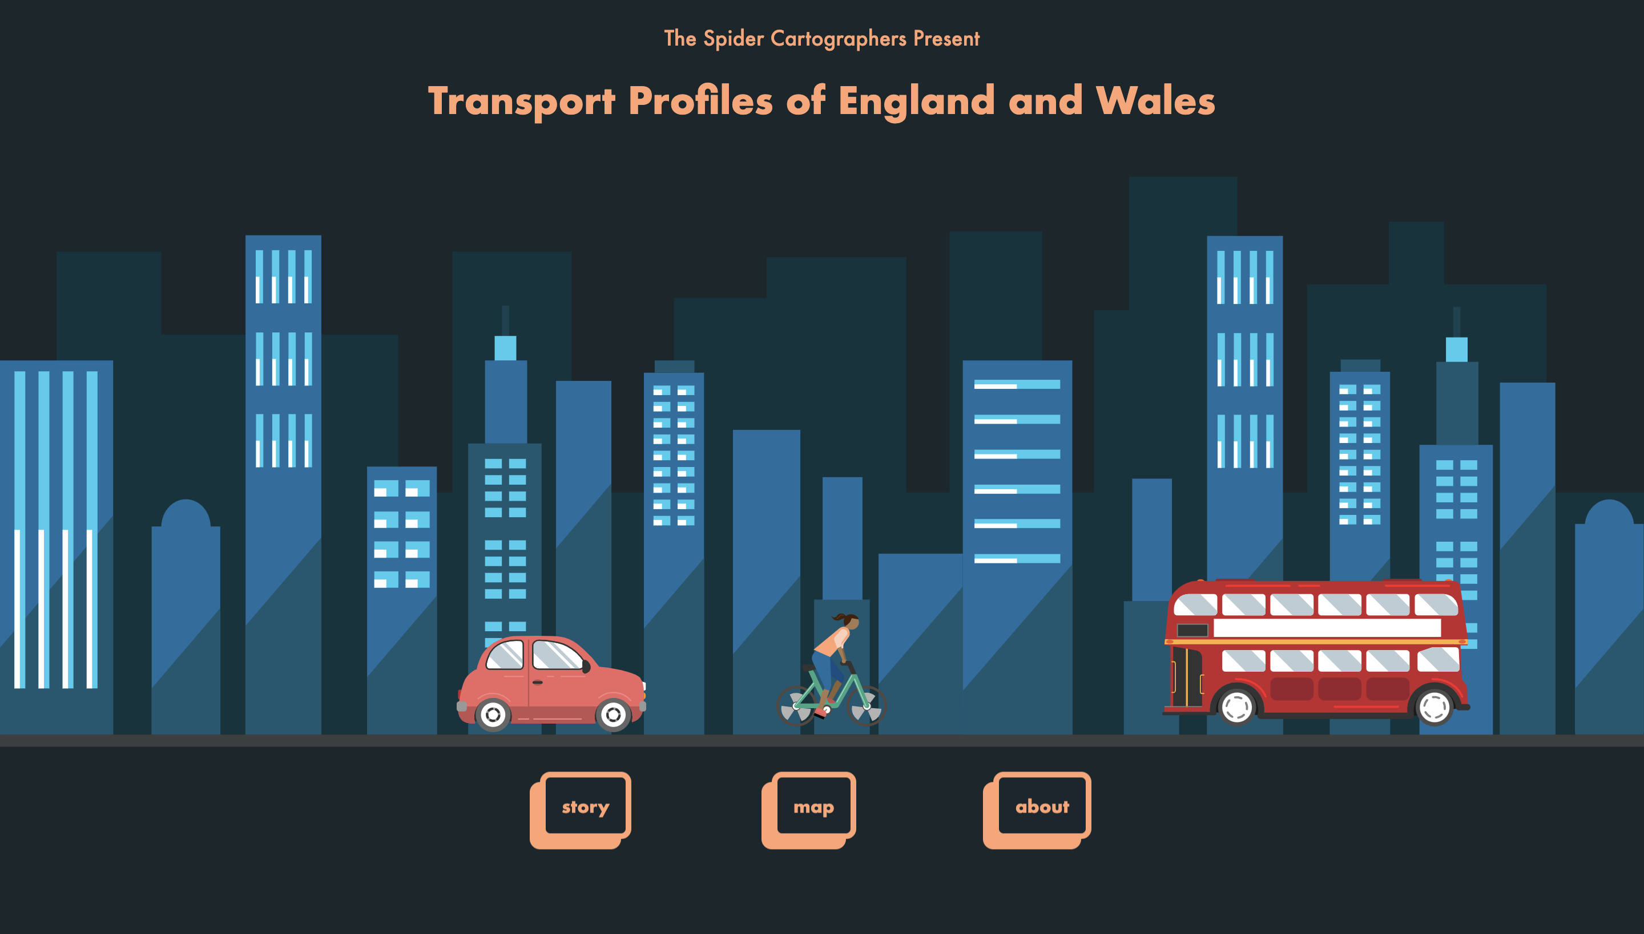
Let’s Visit the site
Notes:
So now that we’ve outlined some of our foundational ideas, let’s take a look around the actual website!

Slide 22

Notes:
We will now take you through each page of our website following the recommended user’s journey!
Our homepage was the first part of the website that we developed.
You can see that we used animation and bright colors to draw in the viewer.
The animations were created by applying CSS and JavaScript functions to SVG elements, which work together to create a city scape.
The menu buttons allow the user to start at any place, although we will start with the story.

Slide 23
Notes:
Our story page guides the user through our thought process about the analysis and highlights our key findings.
It begins with a quote by Enrique Penalosa, as we feel that urban design and transportation play a vital role in shaping happiness.
We included a graphic of the MSOA map, created using QGIS, to allow the user to understand the spatial scale we were using before they explore the interactive map.
We used chartJS, Jquery, and D3 to create interactive figures throughout the story, so the user can further explore the data.
The story telling effect is enhanced by using ‘scrollytelling’, a library used by the New York Times which creates a blurred transition.
At the end of the story page, we link out to further readings and we take the user to the next next, the interactive map page…

Slide 24
Notes:
The first thing the user sees on the interactive map page is a welcome pop up that gives them information about how to use the map and directs them back to the story page if they haven’t read that yet.
Once entering the interactive map page, the user will see a ‘dashboard’ layout with the map on the right and several options and visuals on the left.
There is also a search bar, where the user could enter an area or an address that they are interested in.
When the user clicks on an MSOA, they will see a bar chart showing the breakdown of transport in that area, compared to the national average.
They can toggle certain clusters on and off, and more info about the clusters is available in an info pop up.
Then, after selecting an MSOA, they can turn on the switch to see the commuting flows. By requiring the user to select an MSOA before viewing flows, we prevent them from trying to load too much data, which would slow down their experience.
The flows are colored based on travel mode, and the thickness corresponds with volume. More info about each flow is shown in a pop up when it is hovered over.
A burger menu is on every page, which allows the user to go between pages.
We will now use it to get to the about page.

Slide 25
Notes:
This page has information about the project and about us.
We also linked out to our methodology, in case a viewer would like to read the full report about how the project was completed.

Slide 26
https://tinyurl.com/EWTransportProfiles
Notes:
Here is a link to our site, in case you want to explore it for yourself, and thank you for listening to our presentation.
Don’t forget to mind the gap!

